Slide 1
Data Visualization

Slide 2
Data Visualization
Data Analysis
Explore the data without any clear idea of what we are looking for.
Detect data structures without any deep analysis
Understand data
Derive information
Communication:
Information
Story telling…

Slide 3
Data Visualization
Scatter
Histogram
BoxPlot:

Slide 4
Scatter plot
A Tool to explore pairs of variables
Show relationship
Show Trends

Slide 5
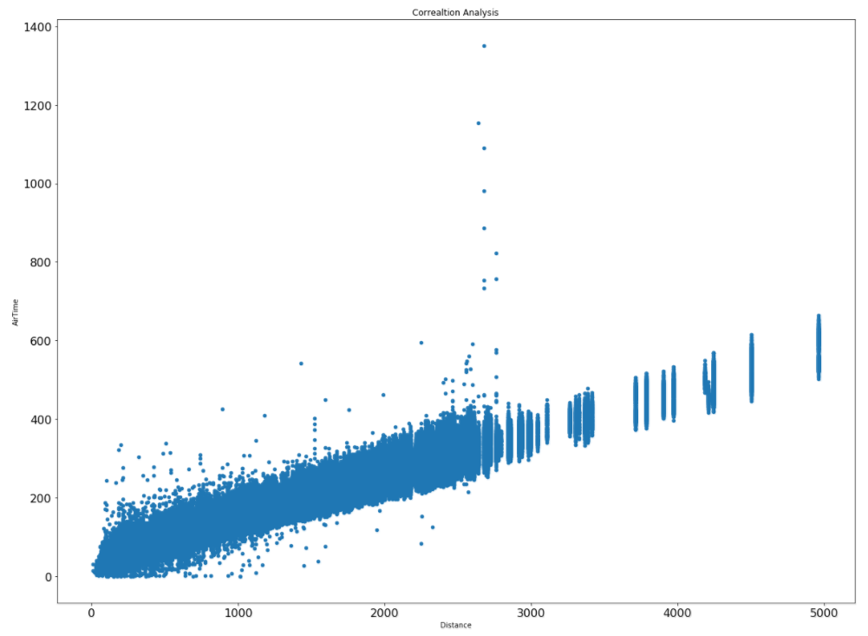
Correlation

Slide 6
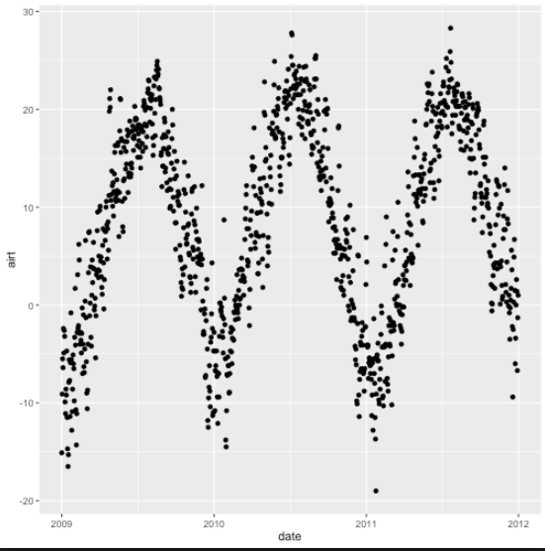
Trend

Slide 7
Histogram
Tools to explore single variables
Frequency analysis
Determine the type/shape distribution (unimodal, bimodal, multimodal)

Slide 8
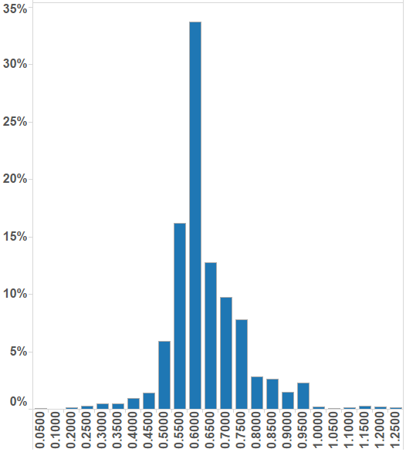
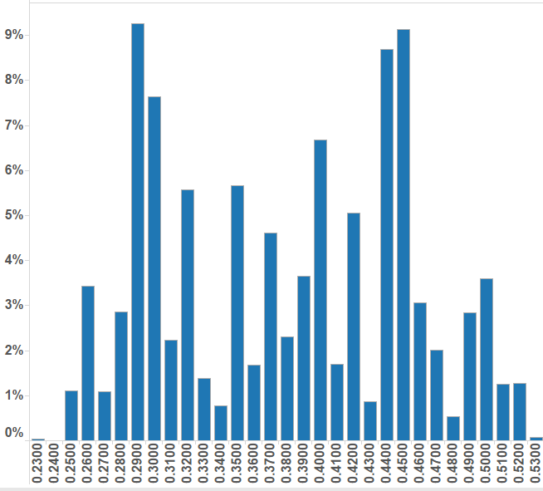
Shape of distribution

Slide 9
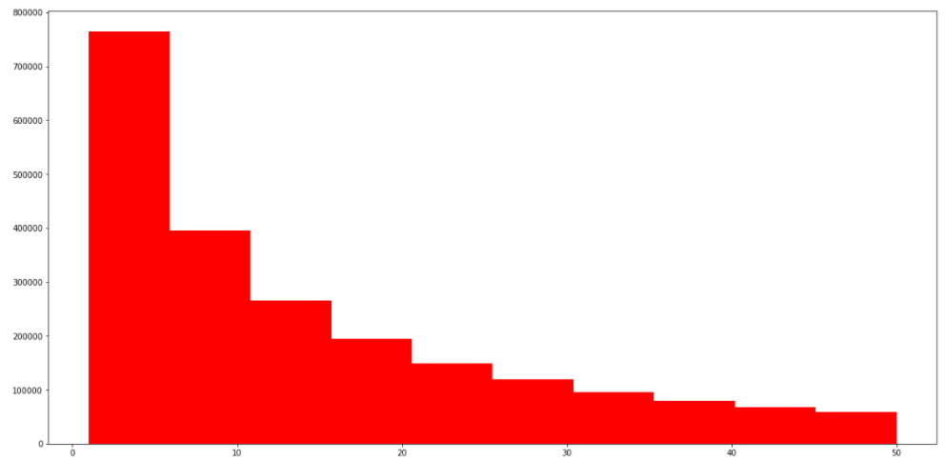
Frequency Analysis

Slide 10
Box Plot
Handles extremely large data set
Comparing two/multi data set easily
Provide key metrics

Slide 11
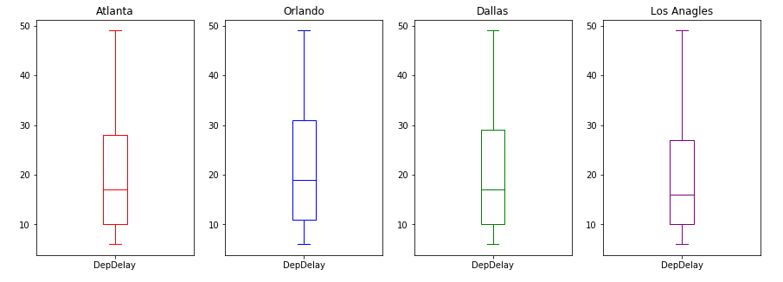
Box Plot

Slide 12
Probability

Slide 13
Population vs Sample

Slide 14
Population vs Sample
Represent the overall population

Slide 15
Sampling (Bias)

Slide 16
Sampling (Bias)
Represent the part of population

Slide 17
Sampling (un-Bias)

Slide 18
Probability
?

Slide 19
Probability
P(red)=50%
?
P(blue)=50%

Slide 20
Probability

Slide 21
Probability
P(red)=50%
?
P(blue)=50%

Slide 22
Probability
Independent events

Slide 23
Probability

Slide 24
Probability
?

Slide 25
Probability
P(red | blue)= 5/9
?
P(blue | blue)=4/9

Slide 26
Probability
Dependent events

Slide 27
Do I have disease with 99.99%?!
Bayes’ Rule
A rare disease: 1 in million have it (0.000001)
There is an accurate test (99.99%)
Result is positive!

Slide 28

Disease Example
1,000,000

Slide 29

Disease Example
1,000,000

Slide 30
Disease Example
1,000,000
100
Test

Slide 31
Disease Example
1,000,000
100
Test

Slide 32
Bayes’ Formula

Slide 33
Bayes’ Formula (Example)

